Slide 1

Digital Commons for a Digital Decade: Exploring Digital Public Goods & Infrastructure
Tony Shannon
Head of Digital Services
Office of Government Chief Information Officer
Government of Ireland
October 2022 @frectally

Slide 2


Slide 3

Stories from the Frontline

Slide 4
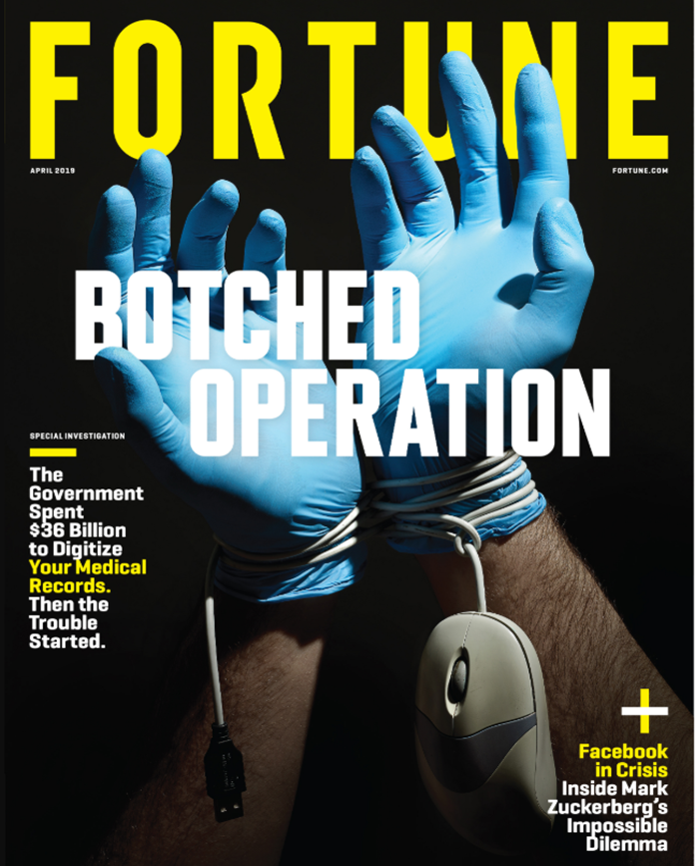

Stories from the Frontline
Notes:
Tony
EP & EM in the NHS
4hr standard success & victim of success
Pressure continues
Need to work smarter > harder
New ways of working

Slide 5
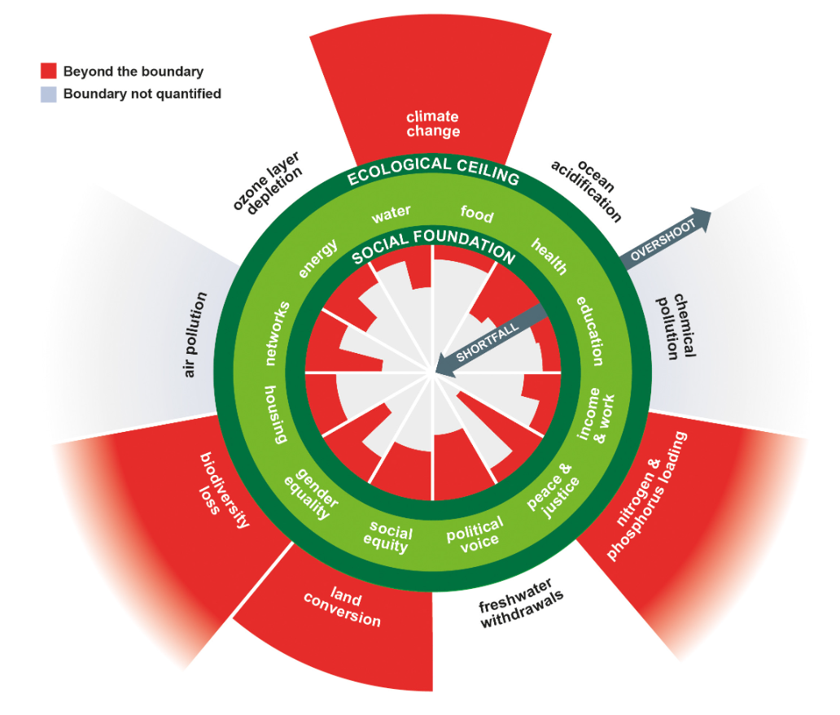
Learnings: 21st Century SocioEconomics

Slide 6
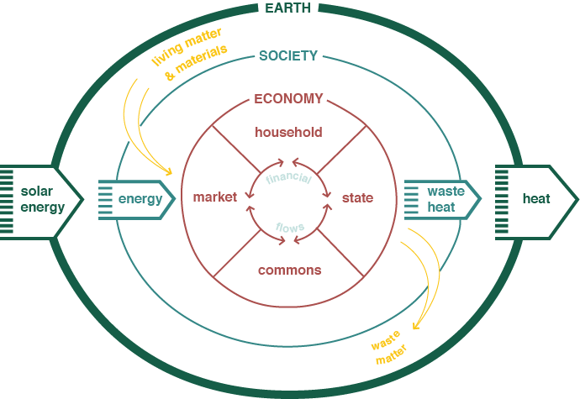
Learnings: Household- State- Market- Commons

Slide 7






Action: Towards a Digital Commons
Icons designed by Freepik.com
User Interface
Information Exchange
Data Repository

Slide 8




Slide 9

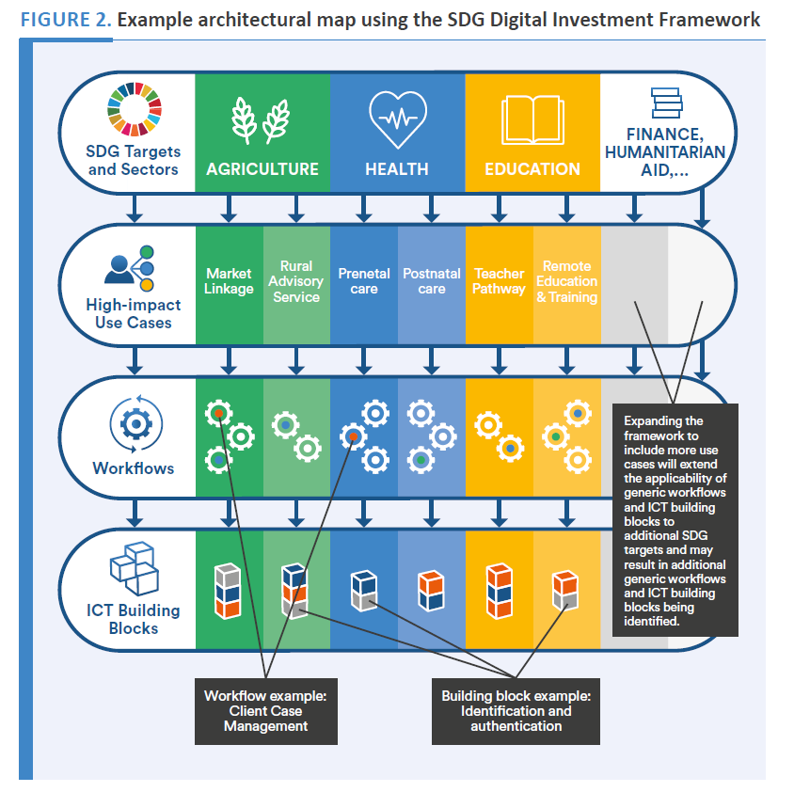


Slide 10
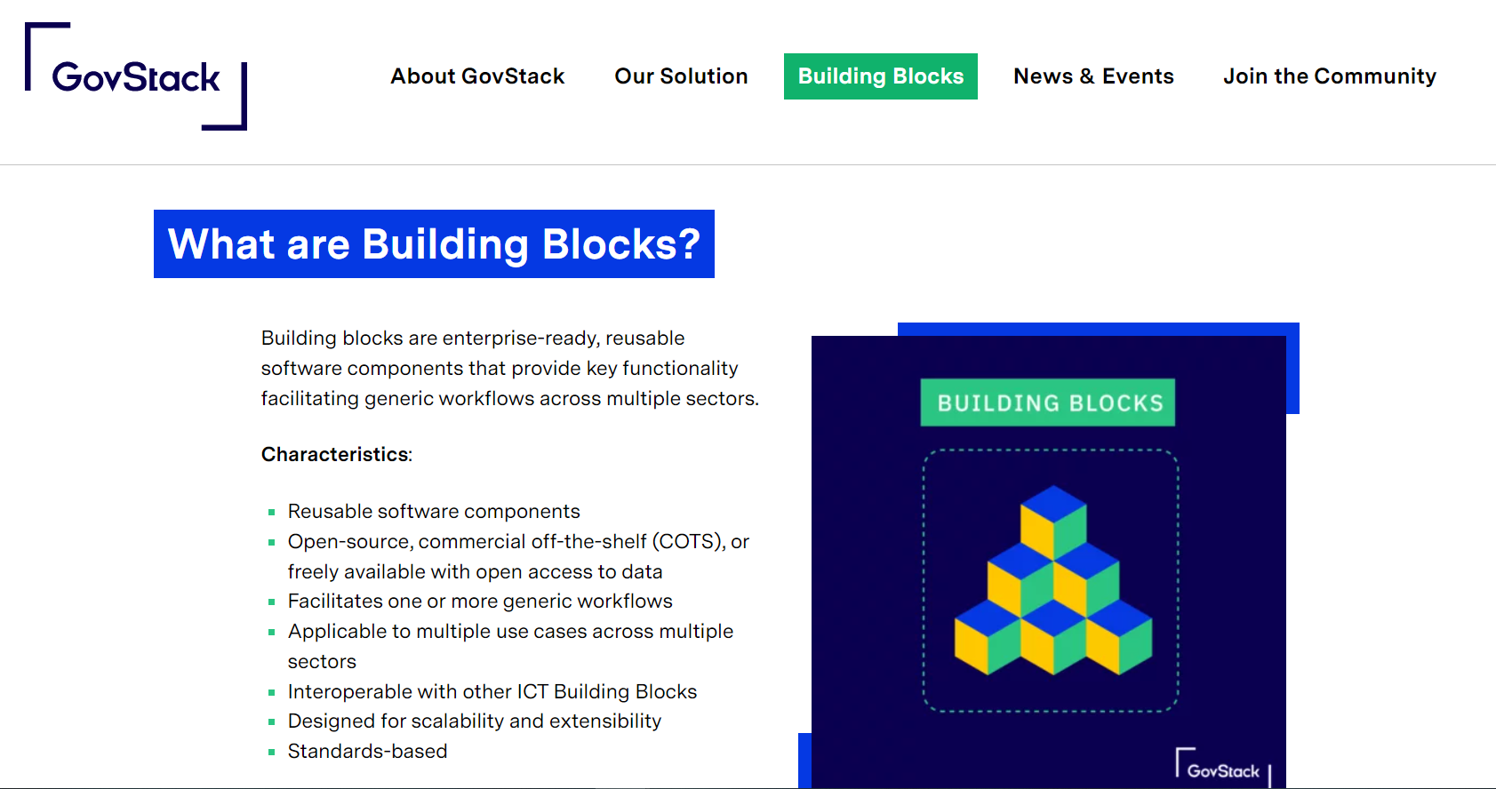


Slide 11

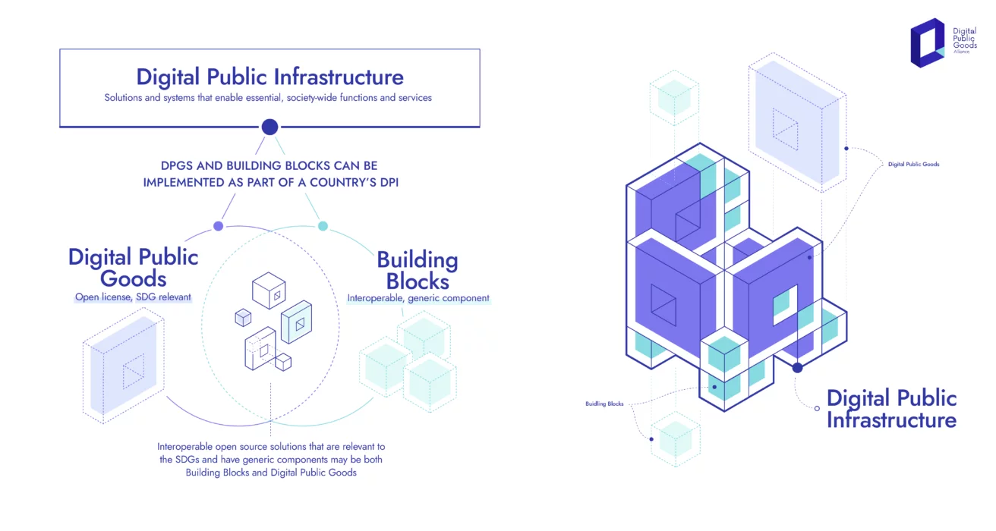
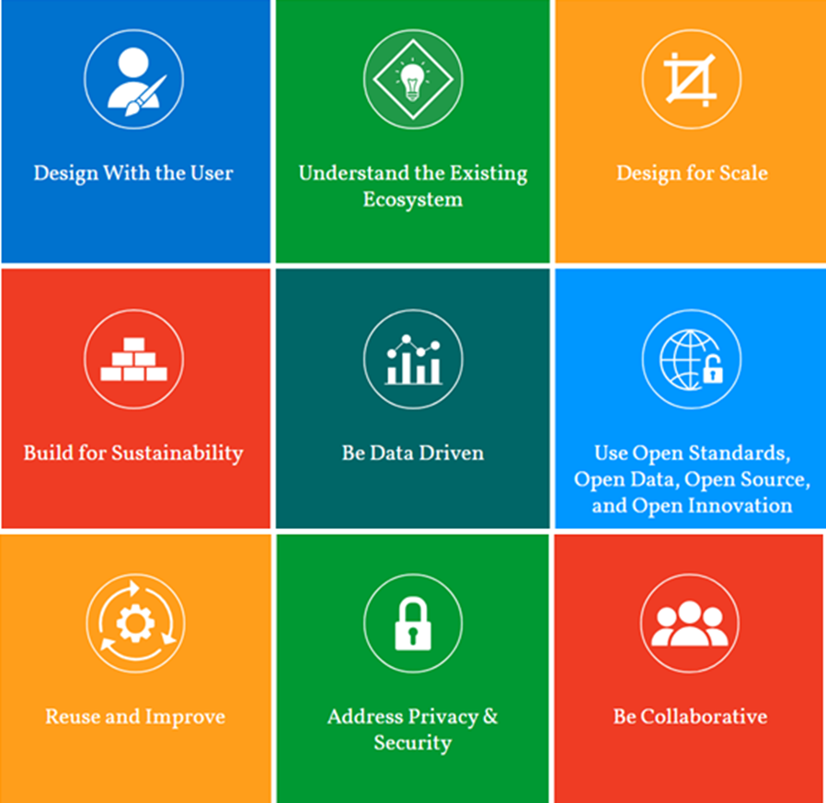

Slide 12
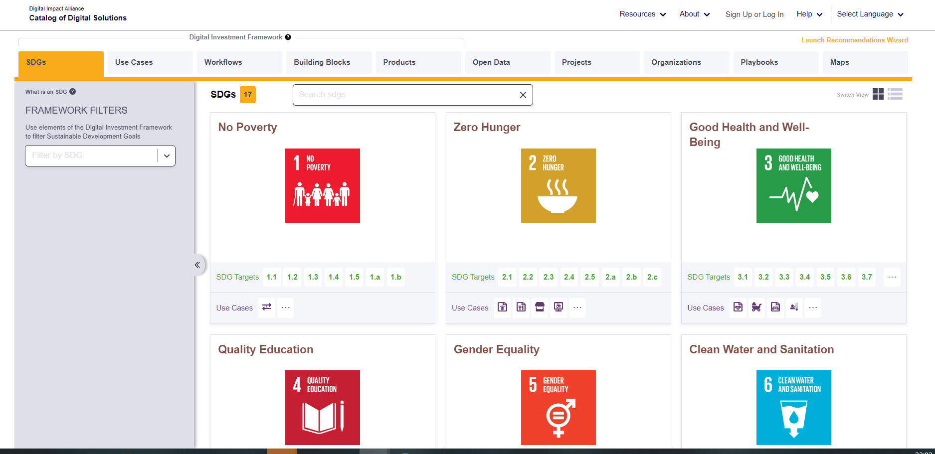


Slide 13
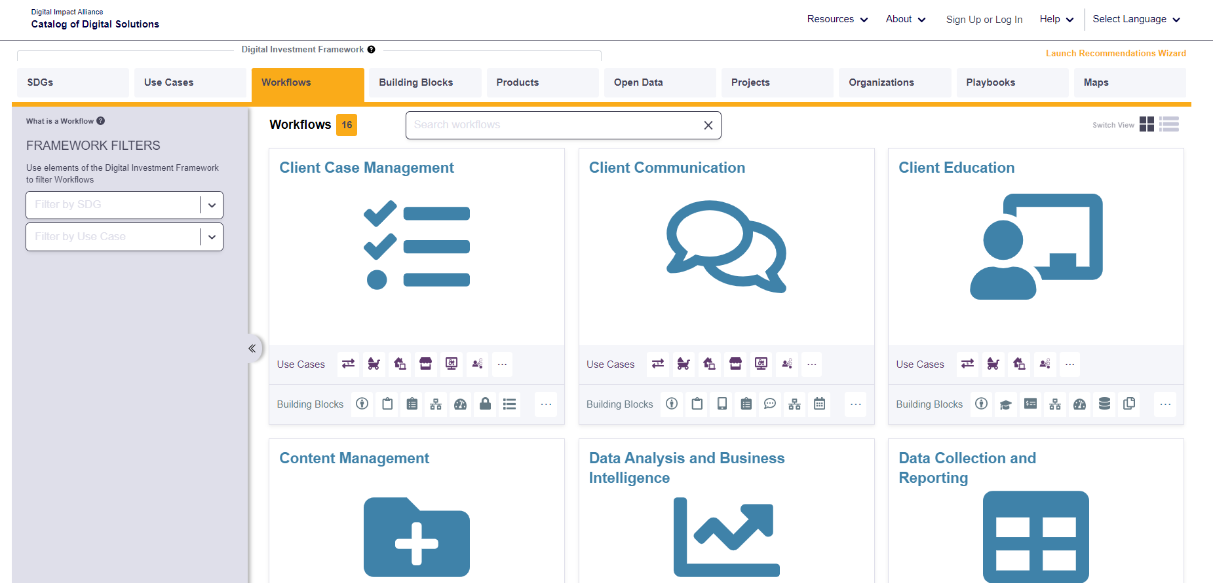

Slide 14
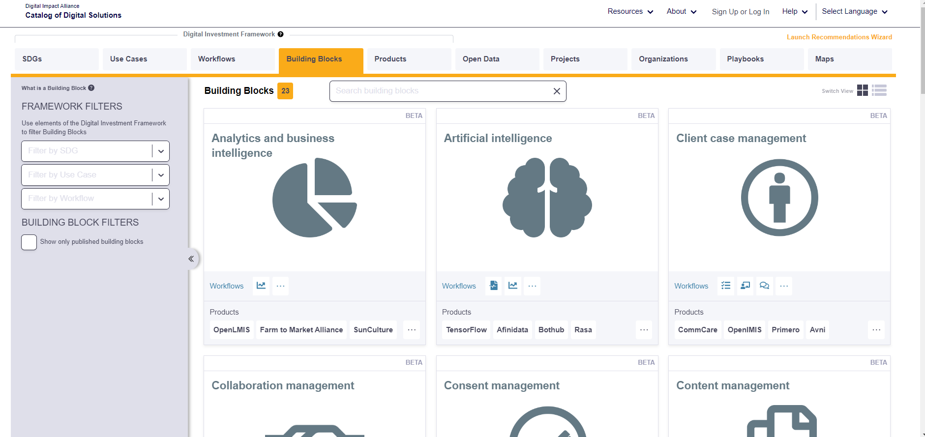

Slide 15
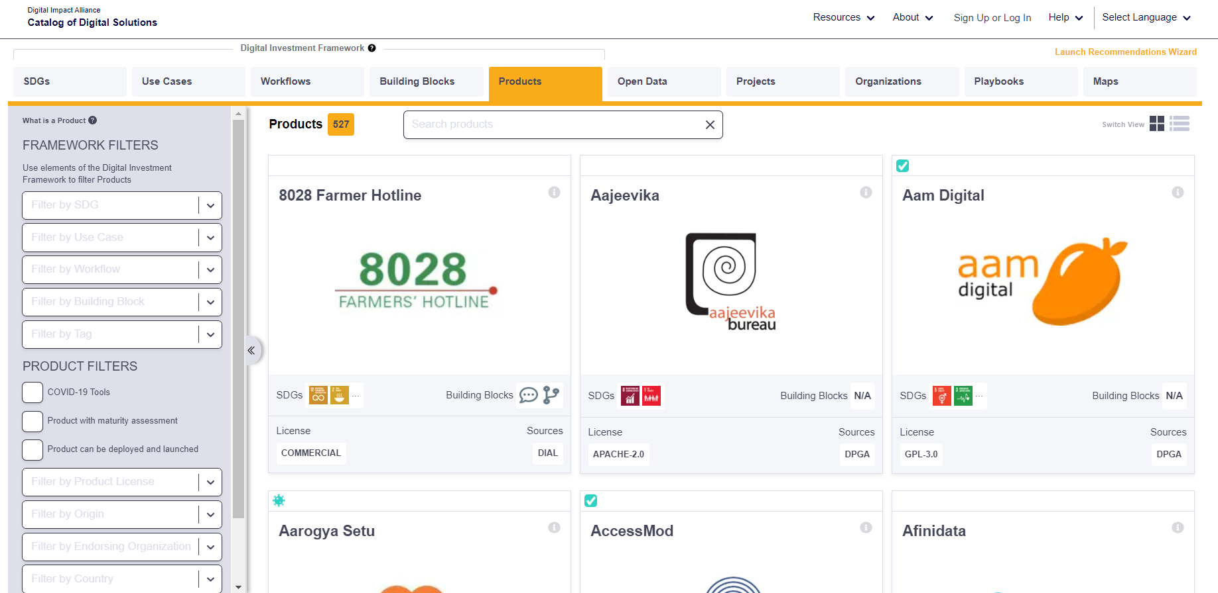

Slide 16
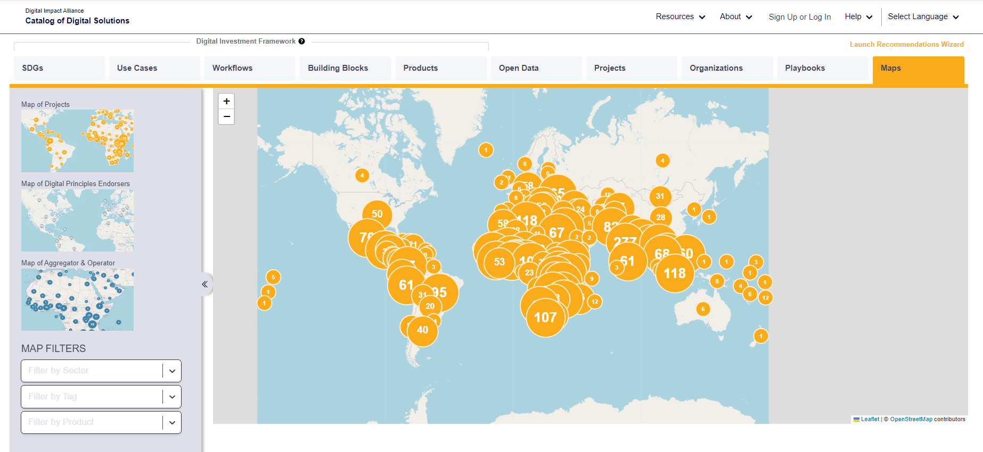

Slide 18
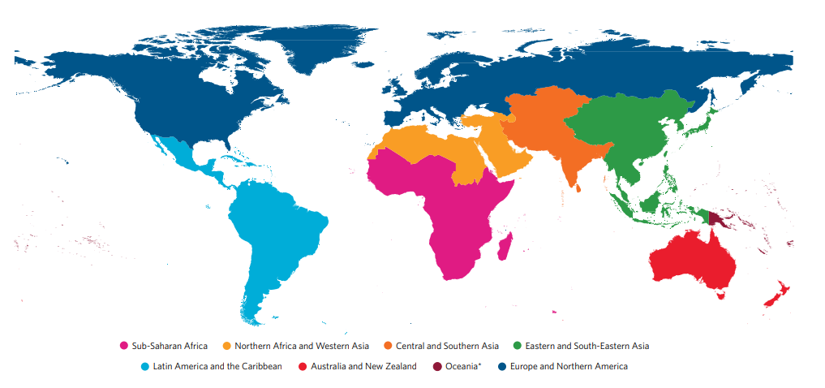
North- South- East- West

Slide 19
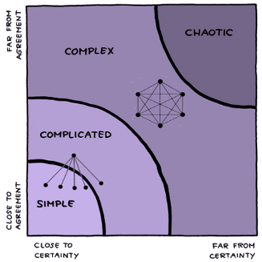

Slide 20


Slide 22
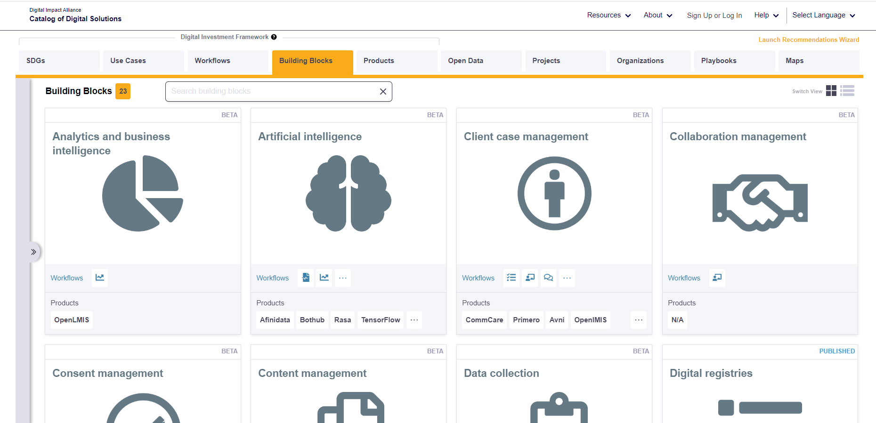

Components in the Commons

Slide 23
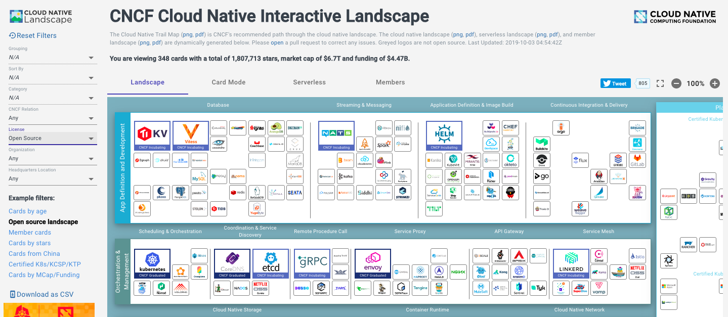

Components in the Cloud
Ripple Foundation C.I.C Ltd
Private & Confidential

Slide 24
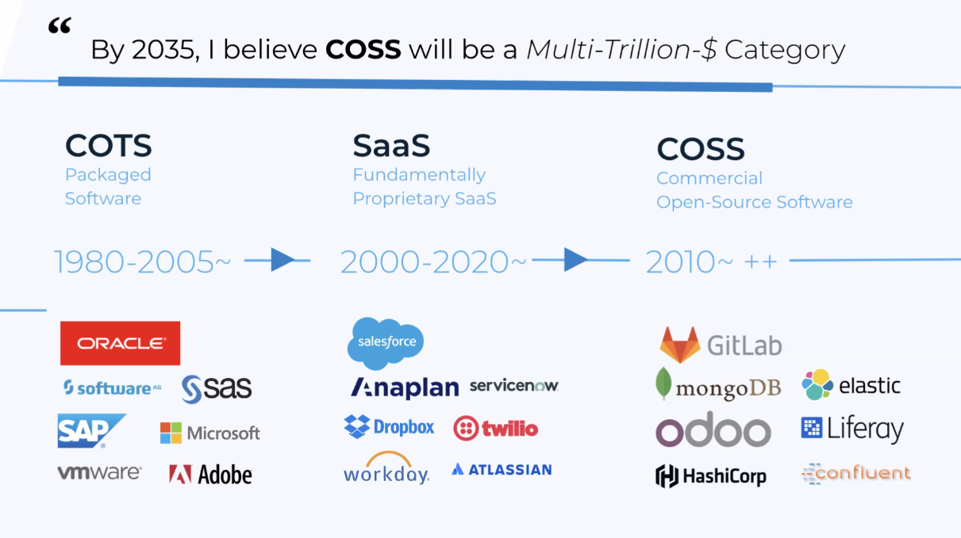
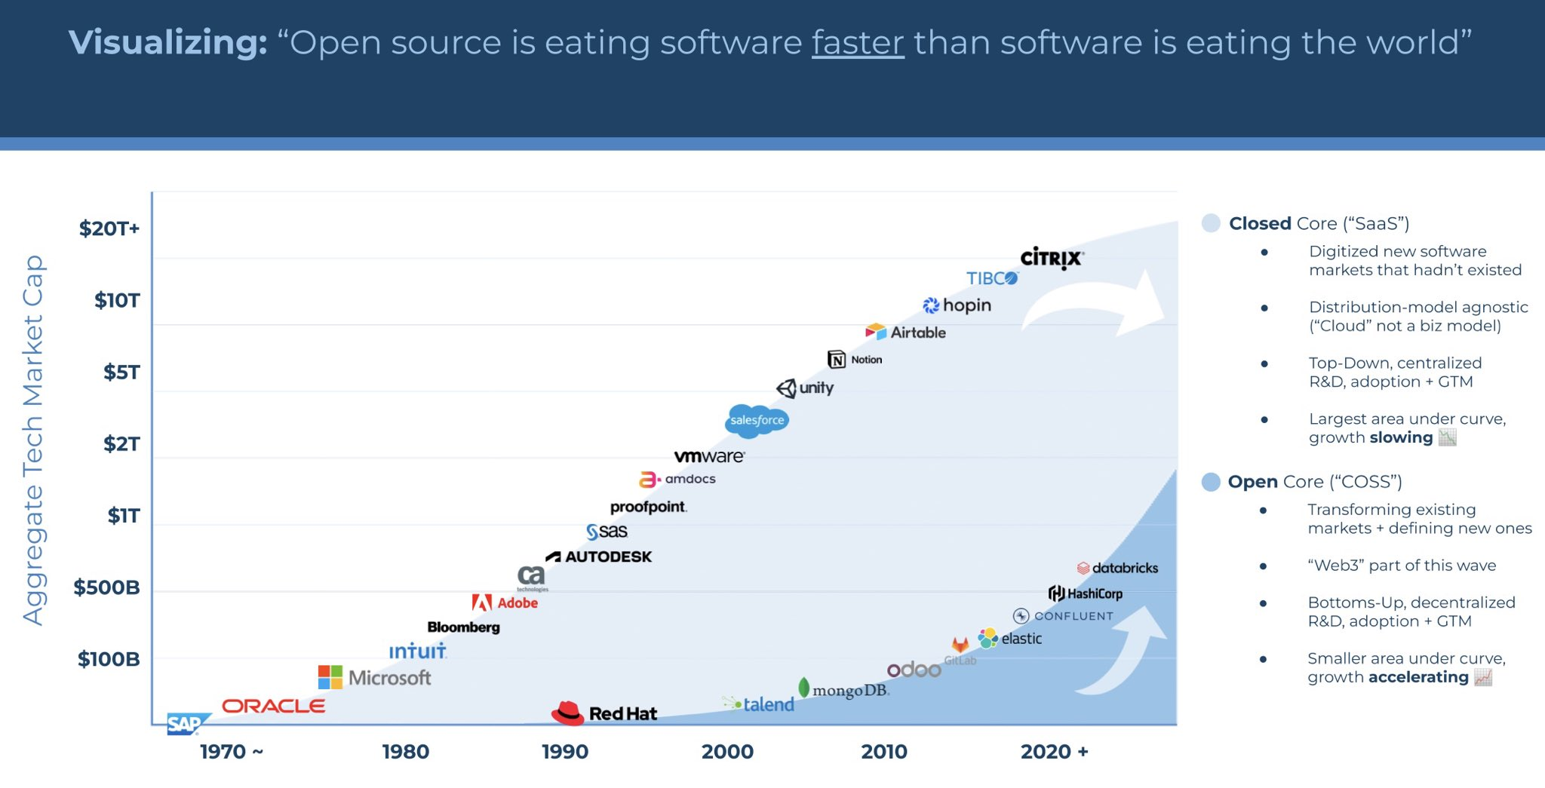
Common Components in the Cloud

Slide 25

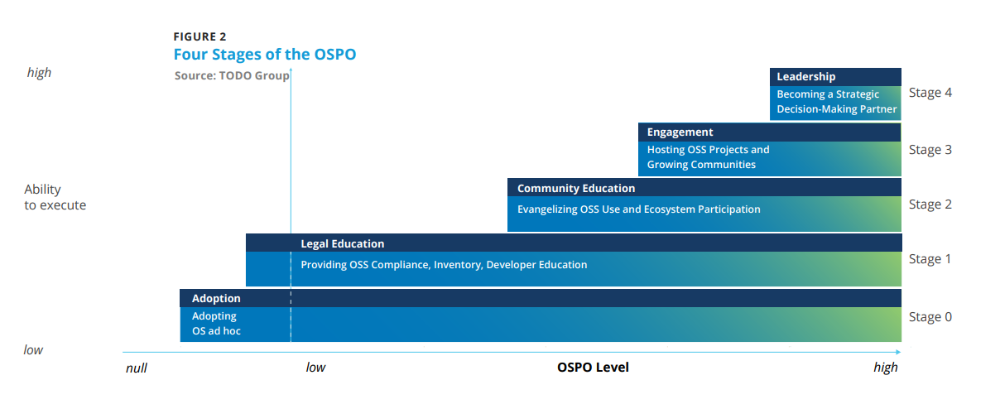
Common Purpose: Common Ground?

Slide 26

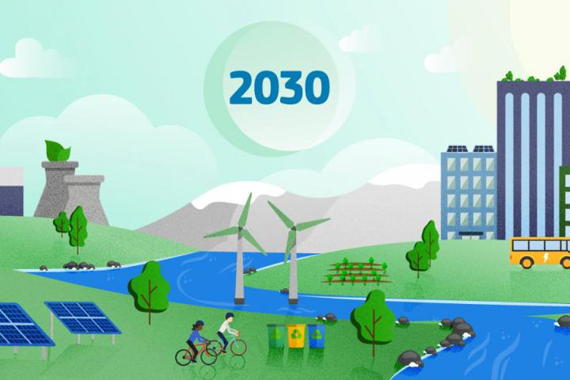
Towards 2030: Decade of Digital & Green
9

Slide 28

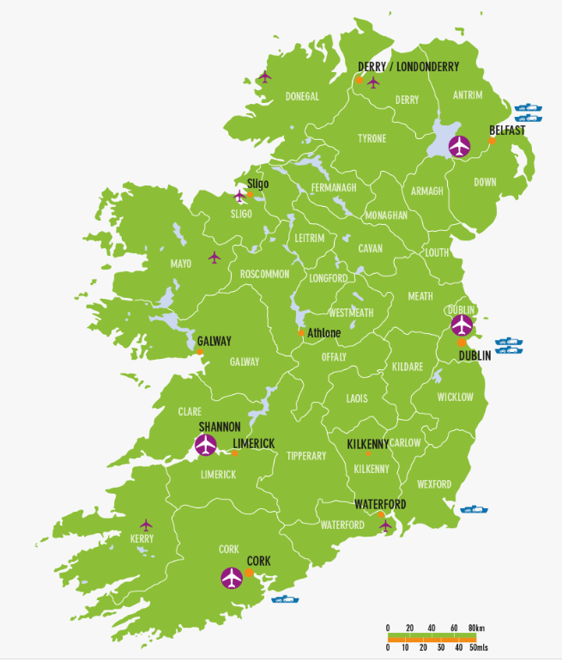


Slide 29
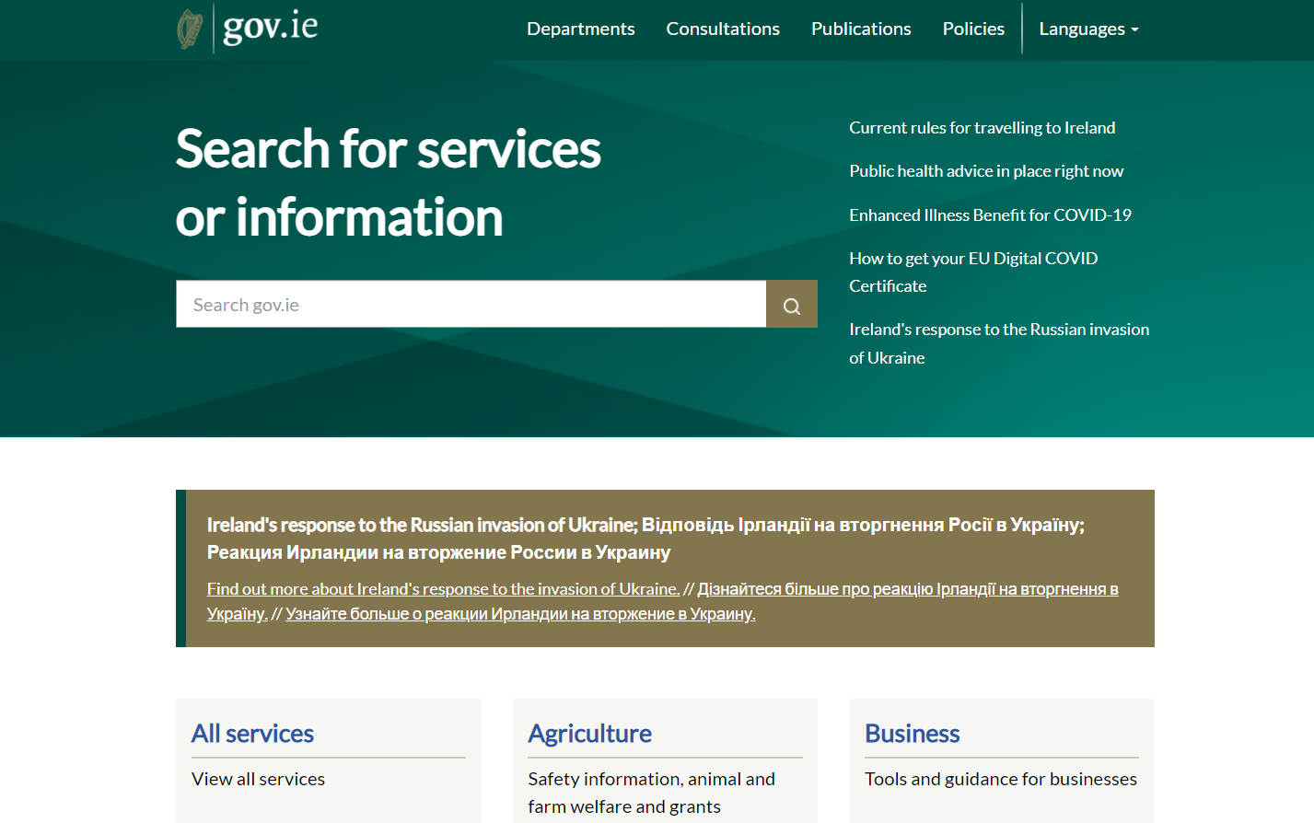

Slide 30
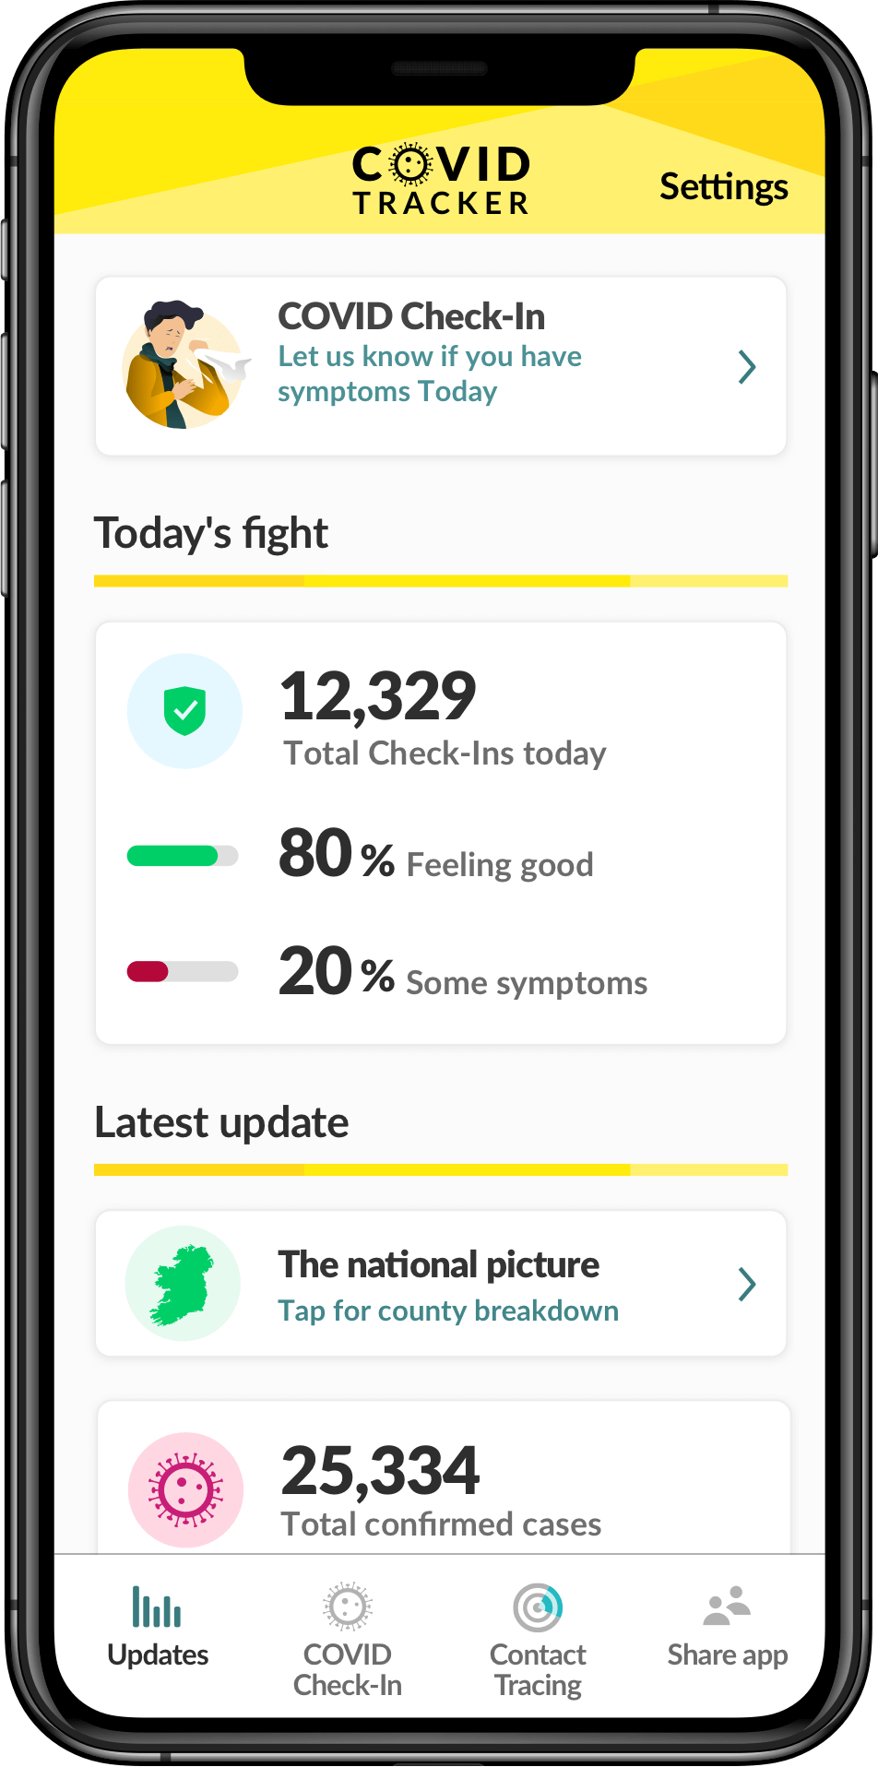


Slide 31
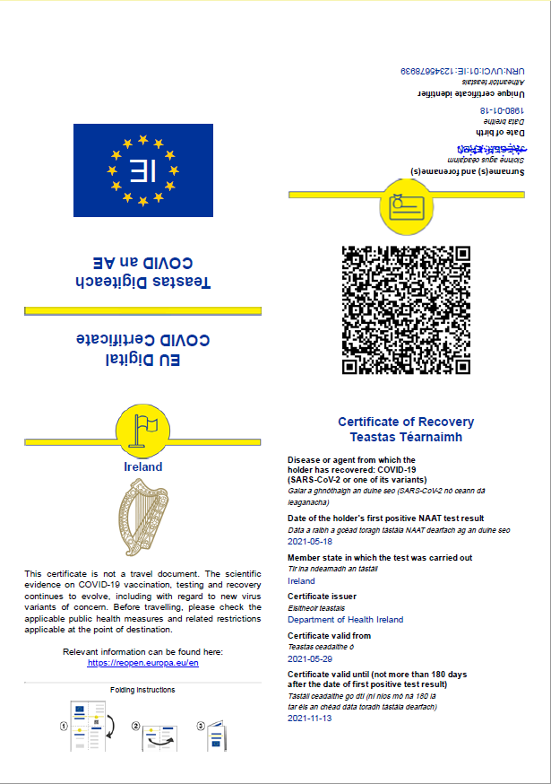
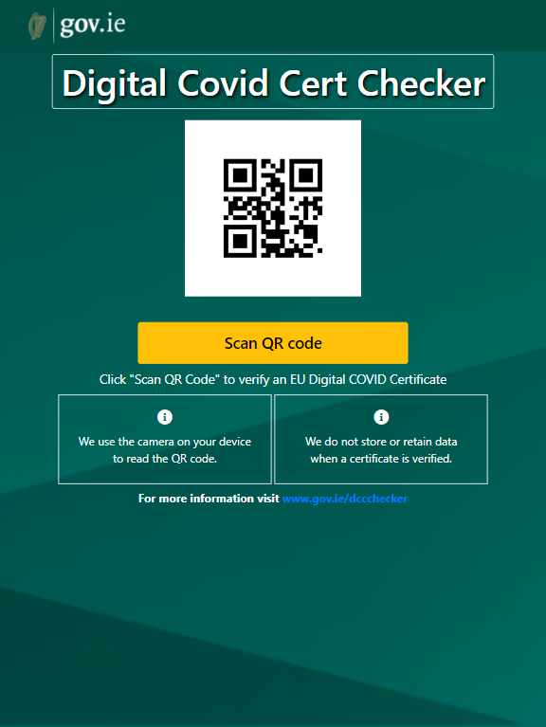

Slide 32



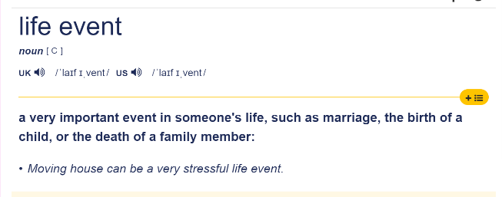


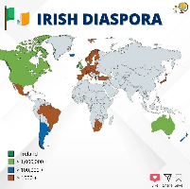



Slide 34



Life Events Portal
Digital Identity
Content Management
Data Collection
Case Management
Messaging
Information Mediator
Analytics

Slide 36
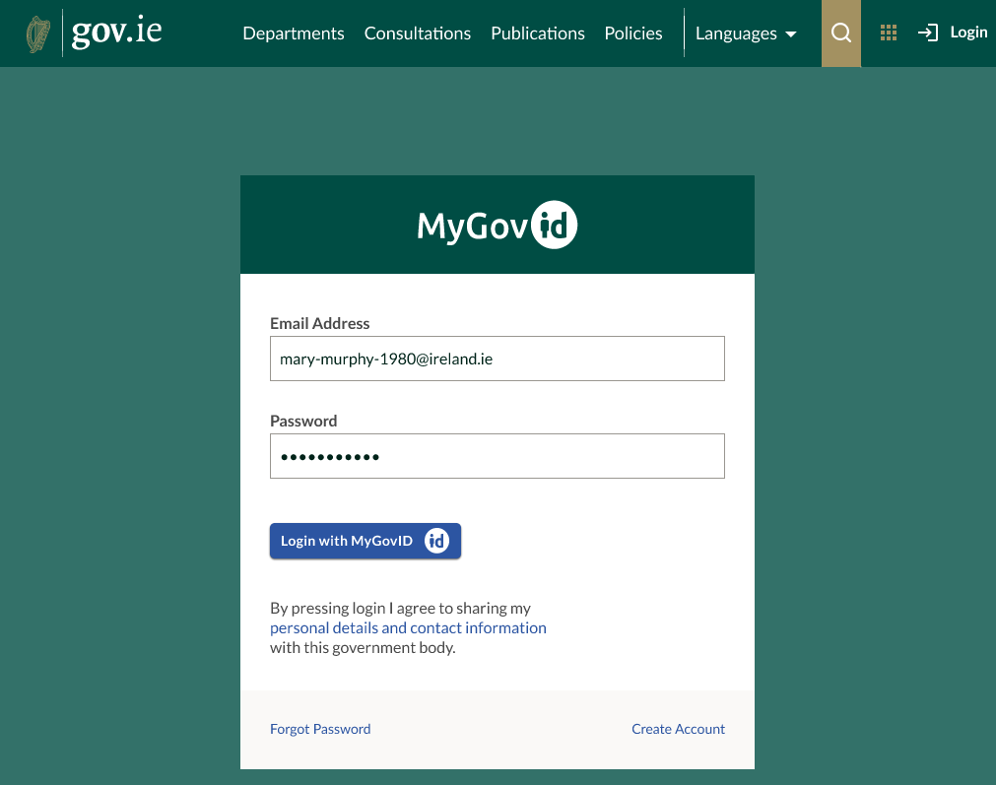

Slide 37
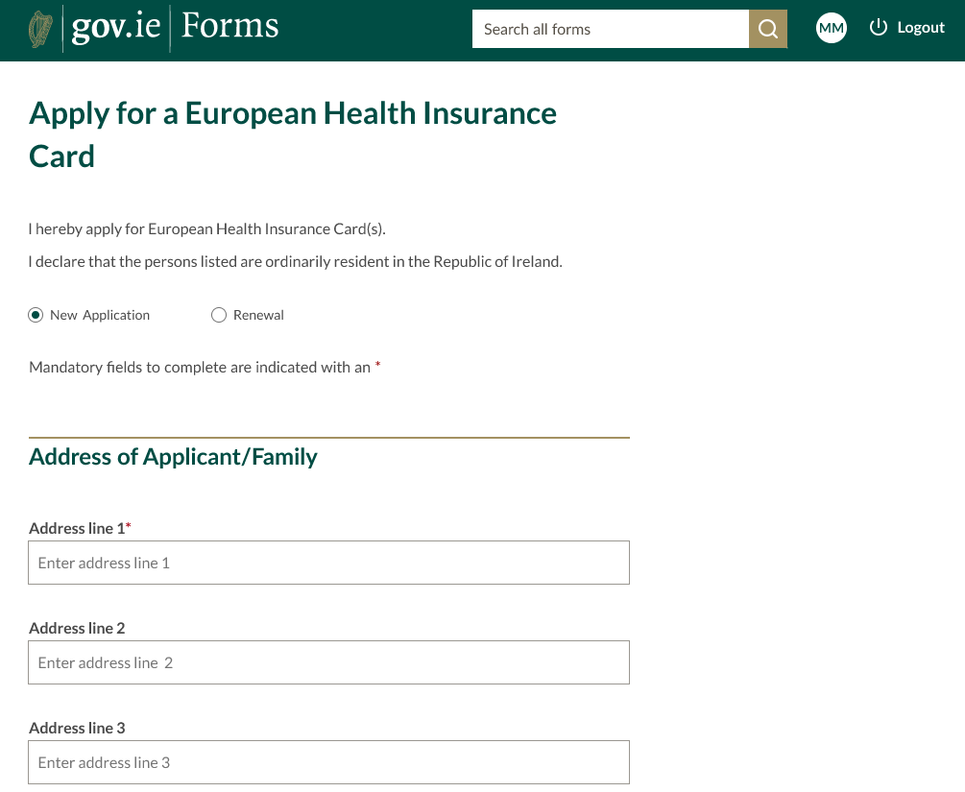

Slide 38
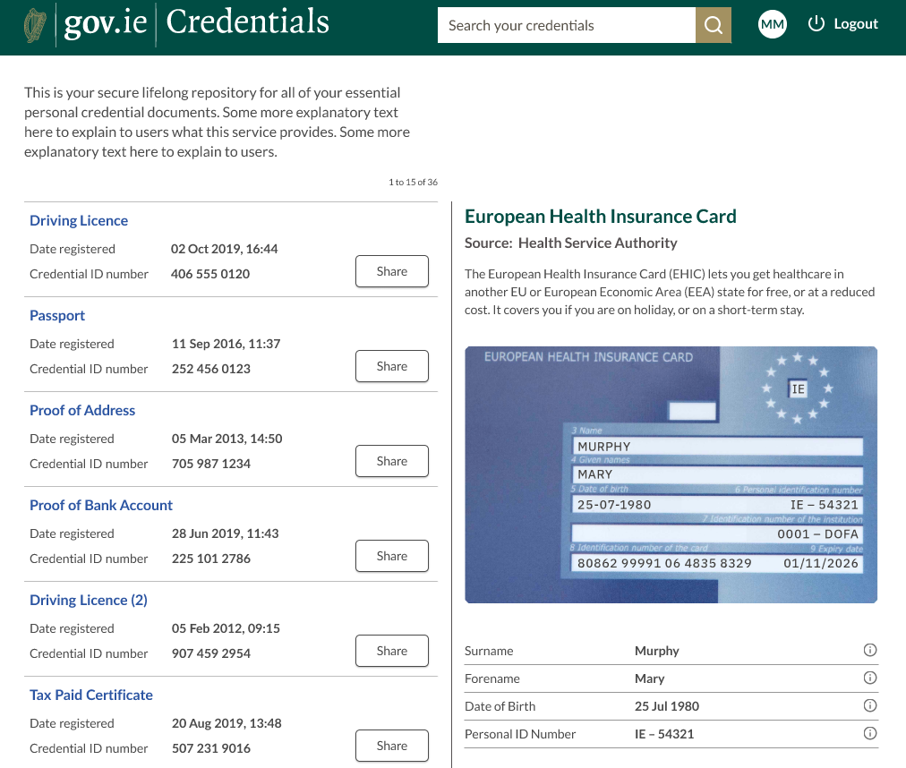


Slide 42

Thank you
Tony Shannon
Head of Digital Services
Office of Government Chief Information Officer
Government of Ireland

